Slide 1
Technical Points

Slide 2
Data Generation
The input is automated wafer testing result (in ohm) for a wafer. In total, there will be 441 locations (21x21) to be processed by the neural network.
The range of the value is in between 0 and 500 ohm.
Results on wafers are gathered and stored in excel file along with manual classification by the technician.
Technician will specify whether it is “Grind”,”Saw” or “Material” issue or combination of that. Hence, there will be 3 columns. In this context, combining 3 columns into 1 class with 8 values from 0 to 7.

Slide 3
Data Generation
The 1090 wafers results are chosen based on:
1. location of saw cuts (angle of the saw cut. It should covers 0,45,90,135,180,225,270,315 direction on the wafer)
2. Pure saw cuts defects should covers 5-45 degree of the wafer edge location.
3. location of grind fails. Grind fails must cover 30-180 degree of wafer edges areas. The dataset must cover all cases where center of grind fails are at 0,45,90,135,180,225,270,315 direction on the wafer.
4. Location of material fails. Usually center of the wafer. Severe material issue causes the radius of failing area to be increased. Therefore, dataset should cover different radius of failing area.
5. Dataset should comprises all combination in 1,2,3,4.
6. Dataset should also cover normal wafer cases with random fails.

Slide 4
Input
Results on 1090 wafers are gathered and stored in excel file along with manual classification by the technician.
The result will then be split into train and test portions.
Each line in csv file represents 1 wafer and hence reshape the raw data into 2D numpy array after test and train data split.

Slide 5
raw_data = pd.read_excel('td6.xlsx',sheet_name = "td6") #raw data
sdarray=raw_data.drop(["saw","grind","dielectric"],axis=1) #Just the features. Drop the outputs
raw_label=raw_data.saw+2*raw_data.grind+4*raw_data.dielectric #The result. Combining 3 rows into value of 0 to 7
sdarray_train,sdarray_test,label_train,label_test = train_test_split(sdarray,raw_label,test_size = 0.2) #split test data
sdarray_train_np=sdarray_train.as_matrix() #Changing input format
twoDarray_train = sdarray_train_np.reshape((sdarray_train_np.shape[0], 21, 21)) # reshape data format to 2D
sdarray_test_np=sdarray_test.as_matrix()
twoDarray_test = sdarray_test_np.reshape((sdarray_test_np.shape[0], 21, 21)) # reshape data format to 2D
trDat=twoDarray_train
trLbl=label_train
tsDat=twoDarray_test
tsLbl=label_test
trDat = trDat.astype('float32')/500 #Convert ohm value to 1
tsDat = tsDat.astype('float32')/500 #

Slide 6
Input
The input will be converted to categorical value.
Number of classes is also accounted.

Slide 7
# Retrieve the row size of each image
# Retrieve the column size of each image
imgrows = trDat.shape[1]
imgclms = trDat.shape[2]
# reshape the data to be [samples][width][height][channel]
# This is required by Keras framework
trDat = trDat.reshape(trDat.shape[0],
imgrows,
imgclms,
1)
tsDat = tsDat.reshape(tsDat.shape[0],
imgrows,
imgclms,
1)
# Perform one hot encoding on the labels
# Retrieve the number of classes in this problem
trLbl = to_categorical(trLbl)
tsLbl = to_categorical(tsLbl)
num_classes = tsLbl.shape[1]

Slide 8
Residual Net Layer – Input Residual Layer
The input shape is (21,21,1)
16 Neurons of conv2D followed by batch normalization and RELU activation layer.
The shape changed to (21,21,16)

Slide 9
def resLyr(inputs,
numFilters=16,
kernelSz=3,
strides=1,
activation='relu',
batchNorm=True,
convFirst=True,
lyrName=None):
convLyr = Conv2D(numFilters, kernel_size=kernelSz, strides=strides, padding='same', kernel_initializer='he_normal', kernel_regularizer=l2(1e-4), name=lyrName+'_conv' if lyrName else None)
x = inputs
if convFirst:
x = convLyr(x)
if batchNorm: x = BatchNormalization(name=lyrName+'_bn' if lyrName else None)(x)
if activation is not None: x = Activation(activation,name=lyrName+'_'+activation if lyrName else None)(x)
else:
if batchNorm: x = BatchNormalization(name=lyrName+'_bn' if lyrName else None)(x)
if activation is not None: x = Activation(activation, name=lyrName+'_'+activation if lyrName else None)(x)
x = convLyr(x)
return x

Slide 10
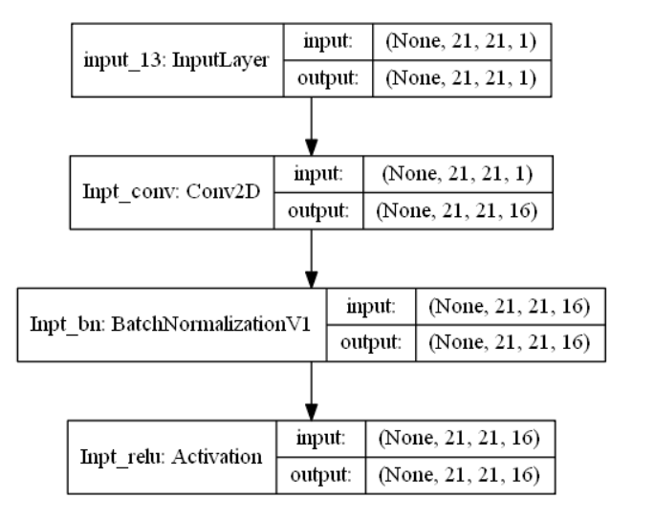

Slide 11
_________________________________________________________________
Layer (type) Output Shape Param #
=================================================================
input_13 (InputLayer) (None, 21, 21, 1) 0
_________________________________________________________________
Inpt_conv (Conv2D) (None, 21, 21, 16) 160
_________________________________________________________________
Inpt_bn (BatchNormalizationV (None, 21, 21, 16) 64
_________________________________________________________________
Inpt_relu (Activation) (None, 21, 21, 16) 0
=================================================================
Total params: 224
Trainable params: 192
Non-trainable params: 32
_

Slide 12
Residual Net Layer – resBlkV1
Consists of 3 blocks for each resBLKV1.
3 resBLKV1 are cascaded after input Residual layer.
After each residual layer, size of the image is reduced.
(21,21) -> (11,11)->(6,6)->(3,3)
After each residual layer, number of neurons increased.
16->32->64->128

Slide 13
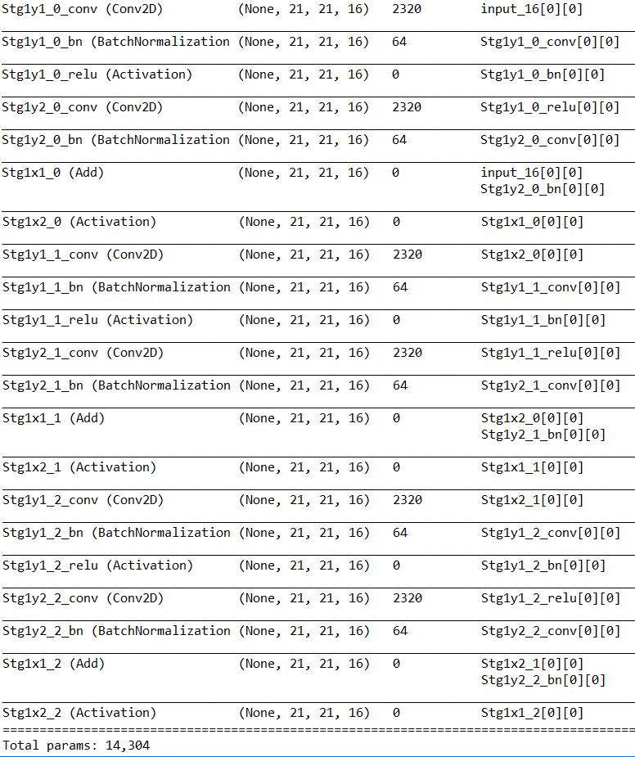

Slide 14
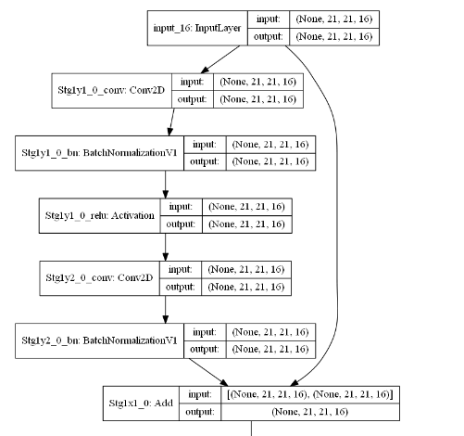
Block 1

Slide 15
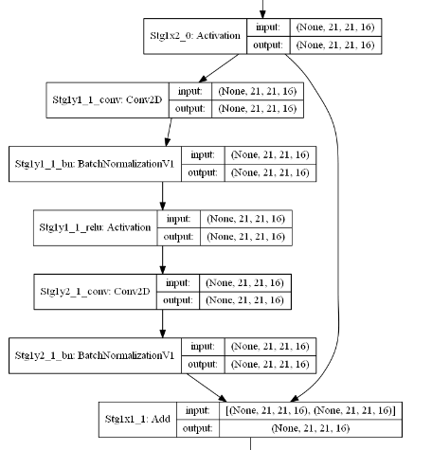
Block 2

Slide 16
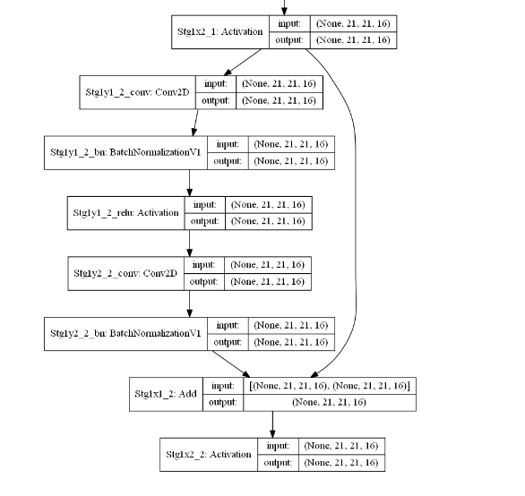
Block 3

Slide 17
Final Layers
The average pooling layers are used to average out the value from final image of (3,3) into just (1,1).
Flatten layer forms the final 1D layer.
Dense at output layer will give the final prediction value for the class.
In total, 1,392,864 parameters are used.

Slide 18
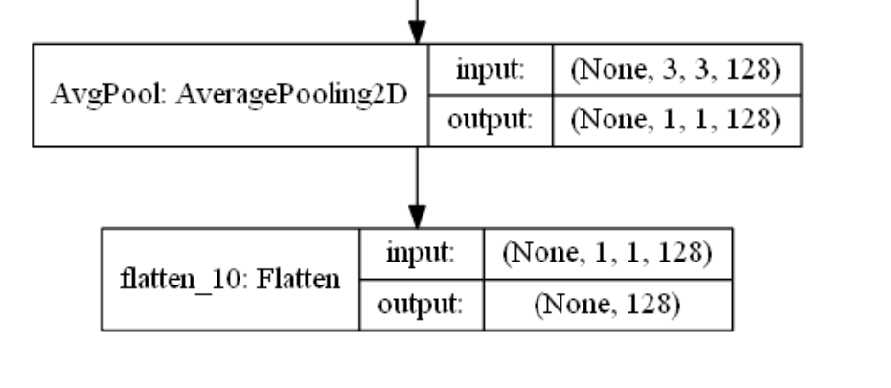

Slide 19
AvgPool (AveragePooling2D) (None, 1, 1, 128) 0 Stg4x2_3[0][0]
__________________________________________________________________________________________________
flatten_10 (Flatten) (None, 128) 0 AvgPool[0][0]
==================================================================================================
Total params: 1,392,864

Slide 20
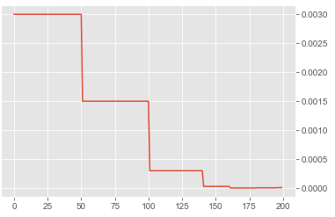
Learning Rate
Applying higher learning rate of 0.3 at the beginning. Apply decay rate in step wise manner when setting the learning scheduler.

